Slide 1

























Linear Regression

Slide 2


















Slide 3


































Slide 4




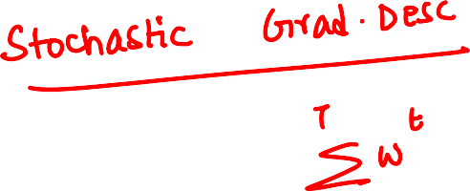










Slide 5





















Slide 6














Slide 7



















Slide 8















Slide 9















Slide 10







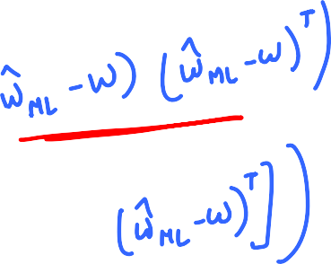

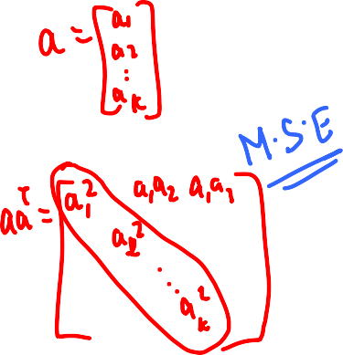





Slide 11













Slide 12















Slide 13




















Slide 14












Slide 15

























Slide 16


K-fold Cross Validation
Leave one out cross validation – K = n

Slide 17













Slide 18

















Slide 19
















Slide 20





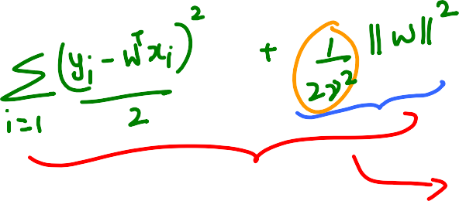










Slide 21
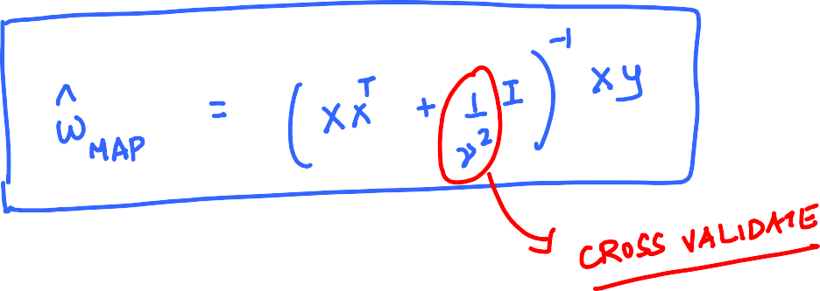

















Slide 22











Slide 23










Slide 24









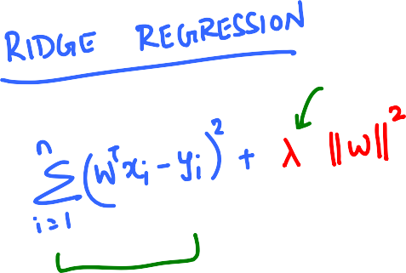





Slide 25

















Slide 26
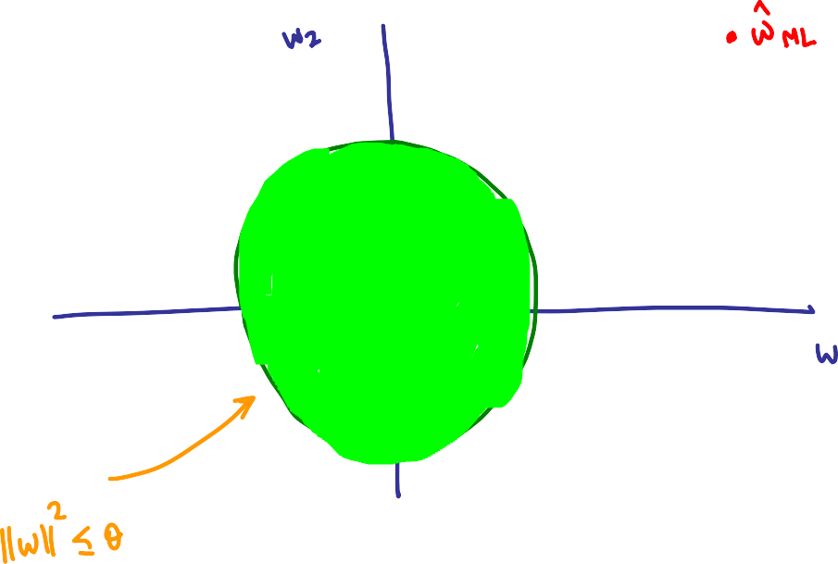













Slide 27








Slide 28











Slide 29
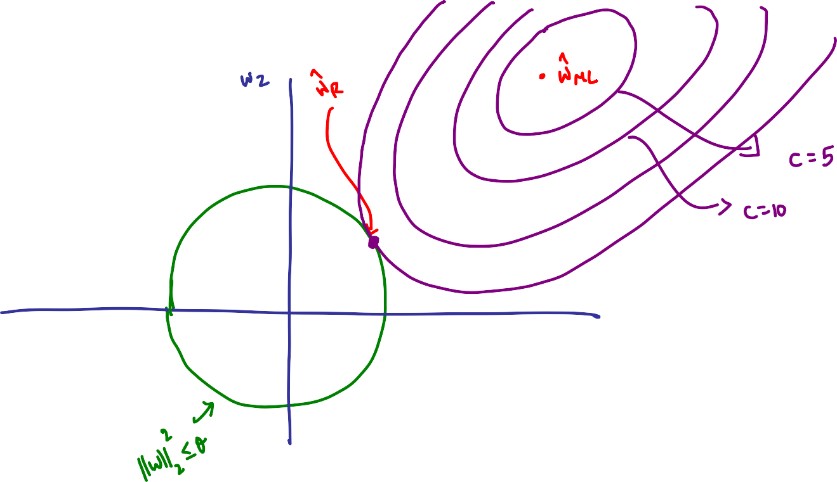






Slide 30
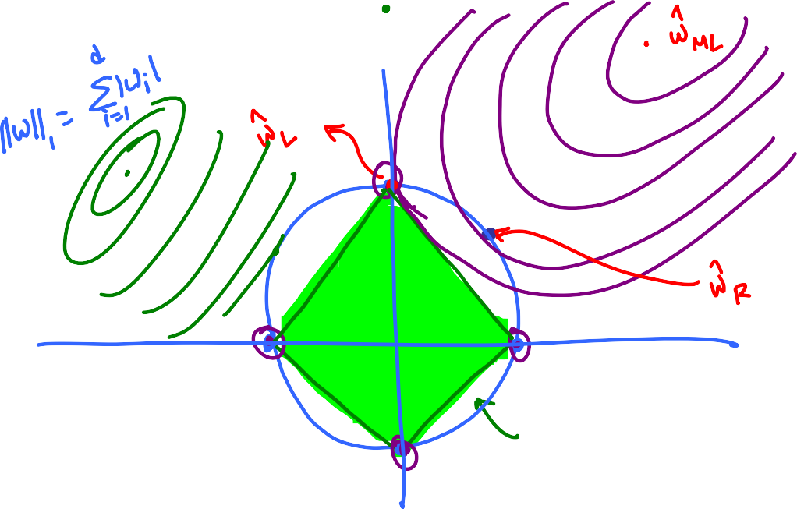







Slide 31


















Slide 32















Slide 34
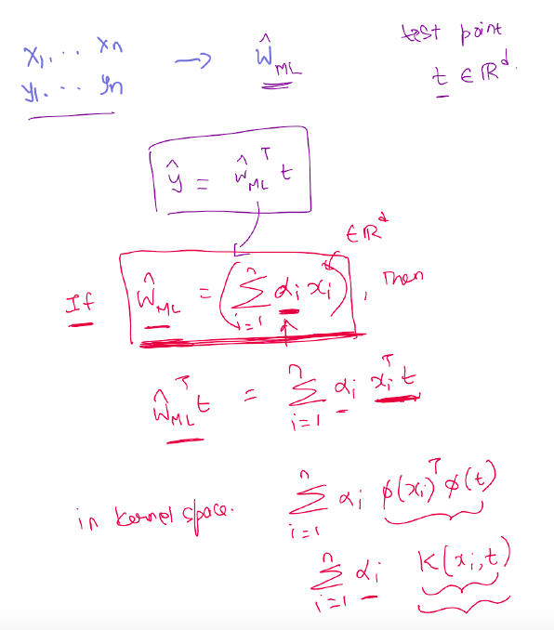

Slide 35

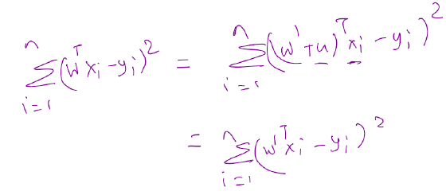
Claimed optimal w
u
x2
w’
x1
x3
w’ is also optimal

Slide 36
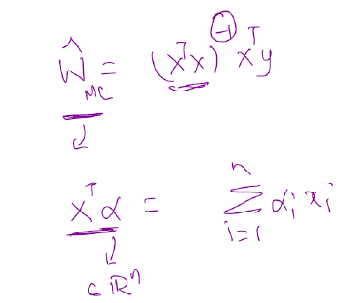
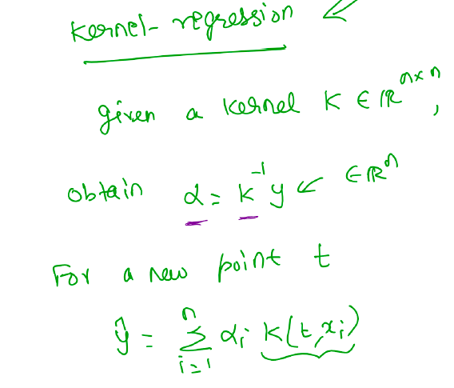
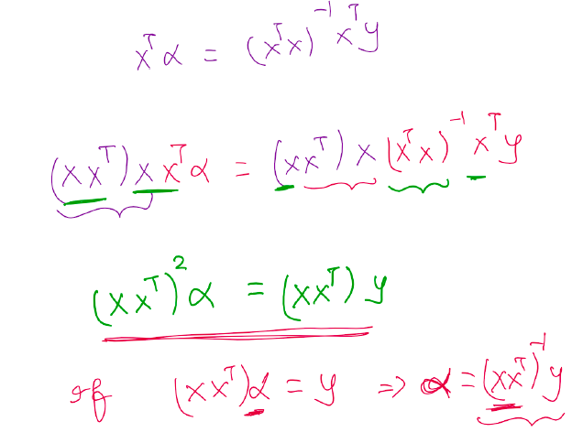

Slide 37


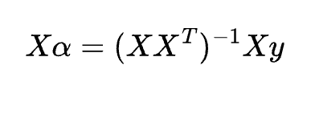



KERNEL

Slide 38
















Slide 39
















Slide 40






Slide 41
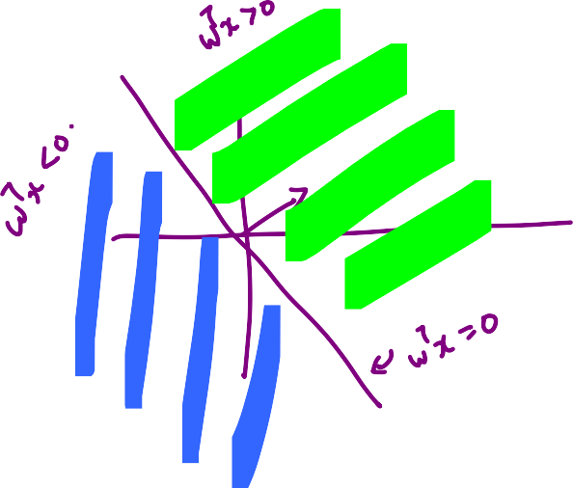
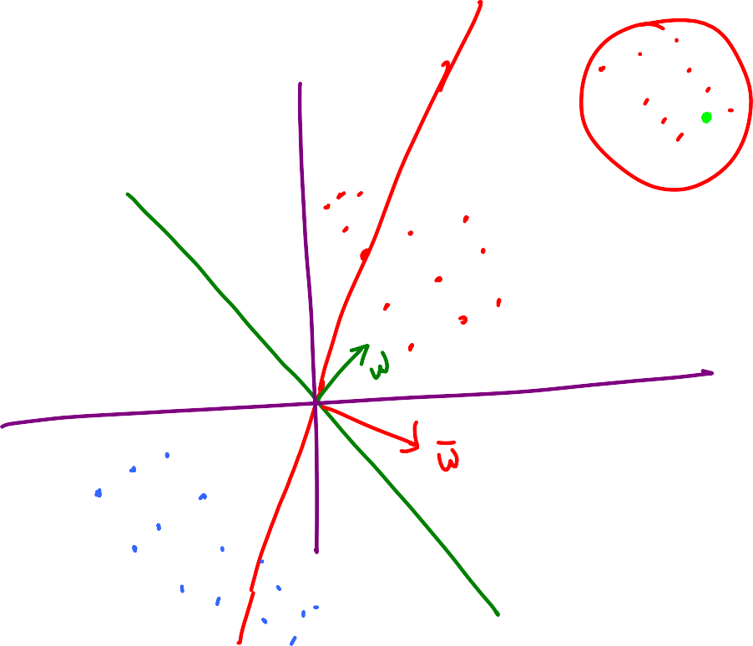




Slide 42











Slide 43















Slide 44
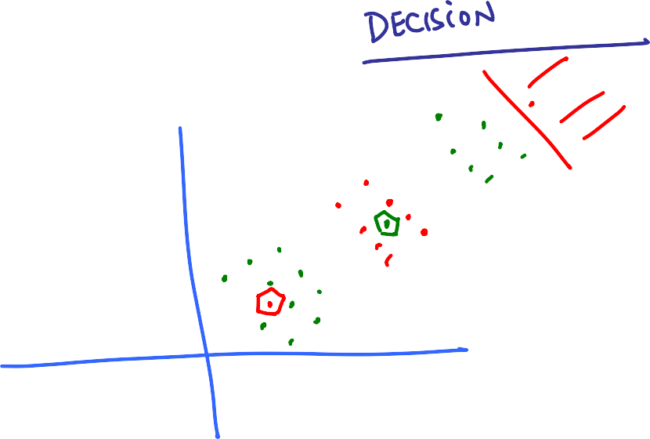


Slide 45
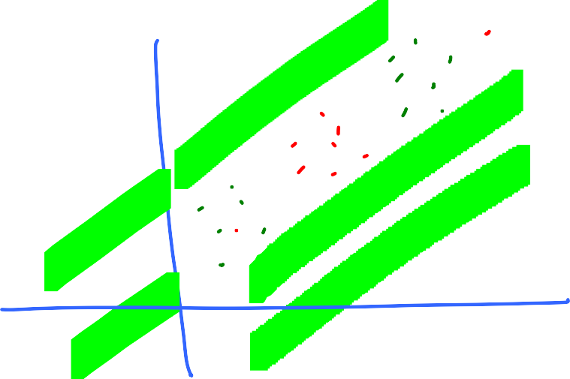





Slide 46

















